Slide 1
HYPERTEXT MARKUP LANGUAGE

Slide 2

Tables in HTML
Table → data arranged into rows & columns
Table headings
rows
columns

Slide 3
Inserting tables in HTML
The table element starts with the <table> tag & ends with the </table> tag.
The table row that creates a horizontal row of cells and contains table headings & table data. |  | <TR> <TH> This is heading </TH> <TD> This is data </TD> </TR>
The table data element to create each individual cell within a row. A <td> tag can contain text, links, images, lists, forms, other tables, etc. |  | <TD> This is cell 1 </TD> <TD> This is cell 2 </TD>
The table heading element creates the heading cells. |  | <TH> This is heading </TH>

Slide 4
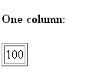
TABLE
<h4>One column:</h4>
<table border="1">
<tr>
<td>100</td>
</tr>
</table>

Slide 5

TABLE
<h4>One row and three columns:</h4>
<table border="1">
<tr>
<td>100</td>
<td>200</td>
<td>300</td>
</tr>
</table>

Slide 6

TABLE
<h4>Two rows and three columns:</h4>
<table border="1">
<tr>
<td>100</td>
<td>200</td>
<td>300</td>
</tr>
<tr>
<td>400</td>
<td>500</td>
<td>600</td>
</tr>
</table>

Slide 7
Inserting tables in HTML
<table>
<tr>
<th>
Menu item
</th>
<th>
</th>
<th>
</th>
</tr>
Calories
Fat
<tr>
<td>
Soup
</td>
<td>
120
</td>
<td>
2
</tr>
</td>
<tr>
<td>
Salad
</td>
<td>
400
</td>
<td>
26
</tr>
</td>
</table>

Slide 8
Practice it!
<body>
<table>
<tr>
<th> Menu Item </th>
<th> Calories </th>
<th> Fat </th> </tr>
<tr>
<td> Soup</td>
<td> 120 </td>
<td> 2 </td> </tr>
<tr>
<td> Salad</td>
<td> 400 </td>
<td> 26 </td></tr>
</table> </body>

Slide 9
Giving caption to tables
Use <caption></caption> tag within the <table> element to describe table.
<table> <caption> table’s description </caption> </table>

Slide 10
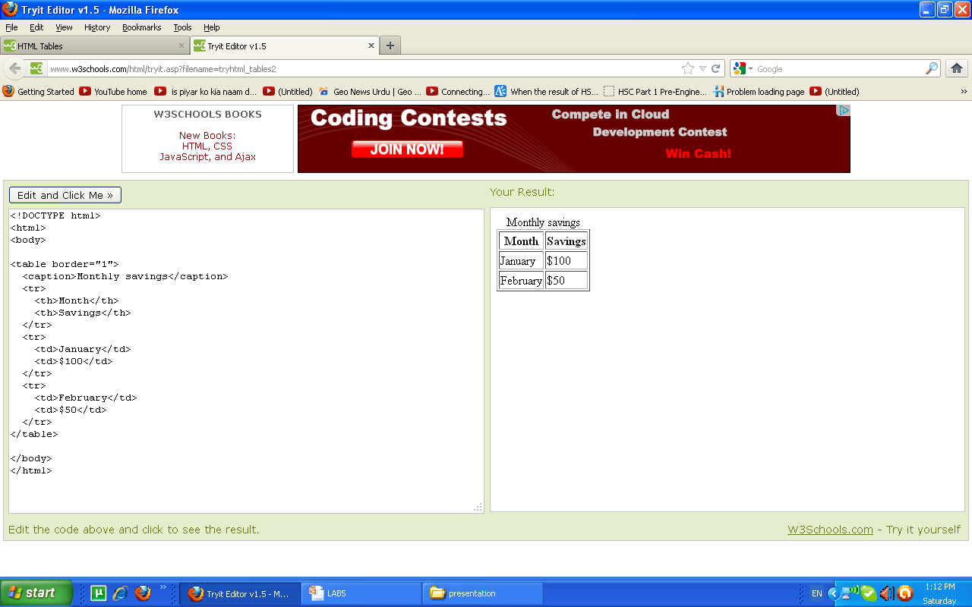
EXAMPLE

Slide 11
Attributes of <table>
Alignment of the entire table |  | <table align=“value”> value can be left, center or right
Width of the entire table |  | <table width=“number”> <table width=“percent”>
Table border |  | <table border=“number”>
Spacing between each neighboring cell |  | <table cellspacing=“5”>
Space between the cell’s content & the cell border |  | <table cellpadding=“10”>

Slide 12
Difference between cell spacing & cell padding
TEXT
TEXT
TEXT
TEXT
TEXT
TEXT
TEXT
TEXT
TEXT
CELLSPACES
CELLPADDING

Slide 13
<td> attributes
Attribute | Description
Align | Horizontally aligns the contents of the cell. Use left, center or right values.
colspan | Specifies the no. of columns a cell spans.
rowspan | Specifies the no. of rows a cell spans.

Slide 14
COLSPAN
View Example
<td colspan=“4”> text </td>

Slide 15
ROWSPAN
View Example
<td rowspan=“5”> text </td>

Slide 16
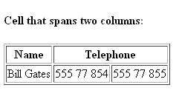
EXAMPLE
<h4>Cell that spans two columns:</h4>
<table border="1">
<tr>
<th>Name</th>
<th colspan="2">Telephone</th>
</tr>
<tr>
<td>Bill Gates</td>
<td>555 77 854</td>
<td>555 77 855</td>
</tr>
</table>

Slide 17
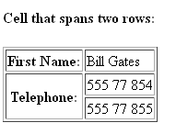
EXAMPLE
<h4>Cell that spans two rows:</h4>
<table border="1">
<tr>
<th>First Name:</th>
<td>Bill Gates</td>
</tr>
<tr>
<th rowspan="2">Telephone:</th>
<td>555 77 854</td>
</tr>
<tr>
<td>555 77 855</td>
</tr>
</table>

